Slide 1


Cross Platform Application
EquiSplit

Slide 2
Team
Batch – 2YB
Paresh Brahmankar
2022SP93036
Rohit Patil
2022SP93039
Rushikesh Kadam
2022SP93040

Slide 3
EquiSplit Your Ultimate Expense Splitting Companion!
Embarking on group adventures, whether it's a weekend getaway, a dinner with friends, or a collaborative project, is undeniably thrilling. Yet, managing shared expenses can often become a labyrinth of confusion and awkwardness. Enter ExpenseSplitter, the solution designed to streamline the process of splitting expenses within groups effortlessly.

Slide 4

Features
Intuitive Expense Tracking
Smart Group Balancing
Real-time Updates
User-Friendly Interface
History and Insights

Slide 5



Architecture
Authentication
service
NodeJS Server
(Render platform)
MongoDB ATLAS
Express router APIS
Mongoose Conn
React Native Platforms

Slide 6
Backend
Payment graph(groupId)
User Table
User service
Group service
Group Table
uid
userdata
gid
List<User>, metadata
Expense service
Expense Table
gid
List<Expenses>

Slide 7
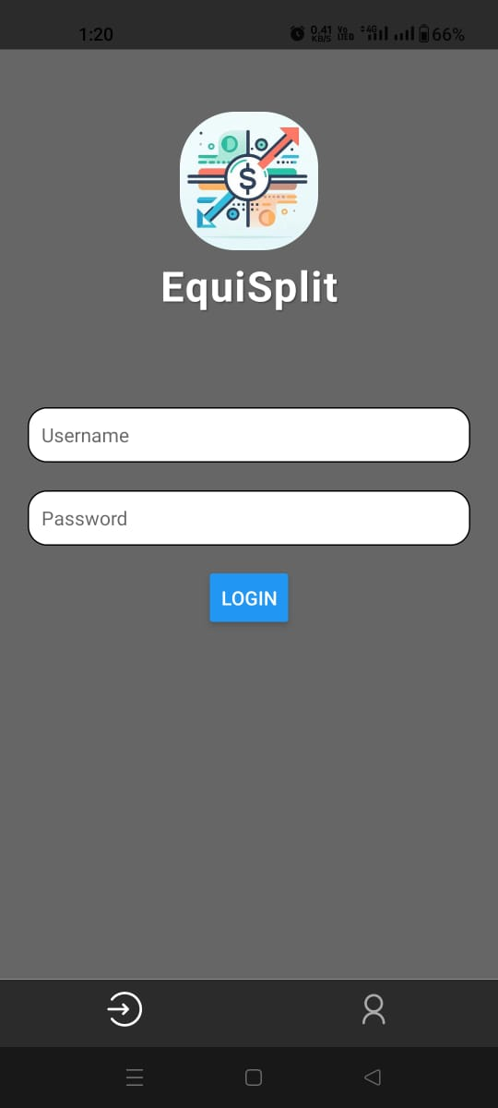
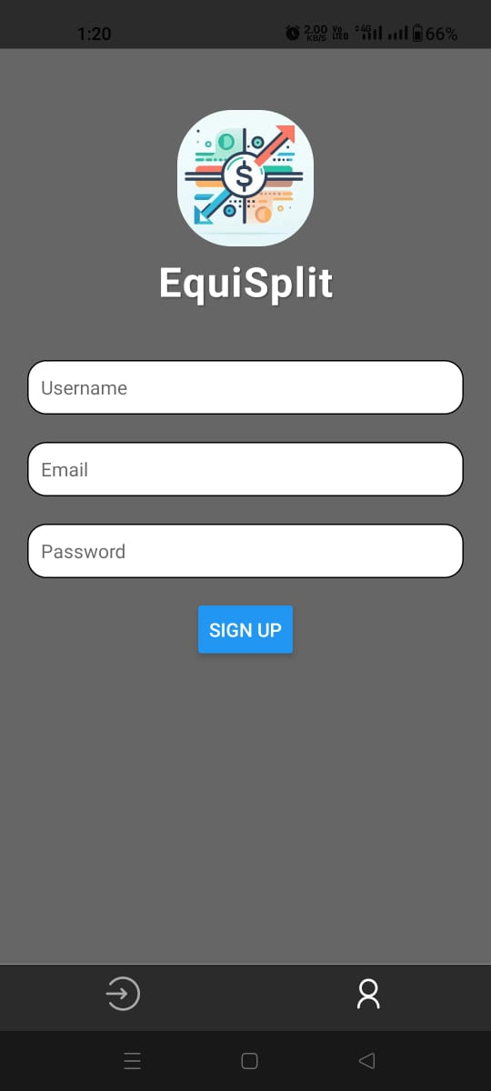
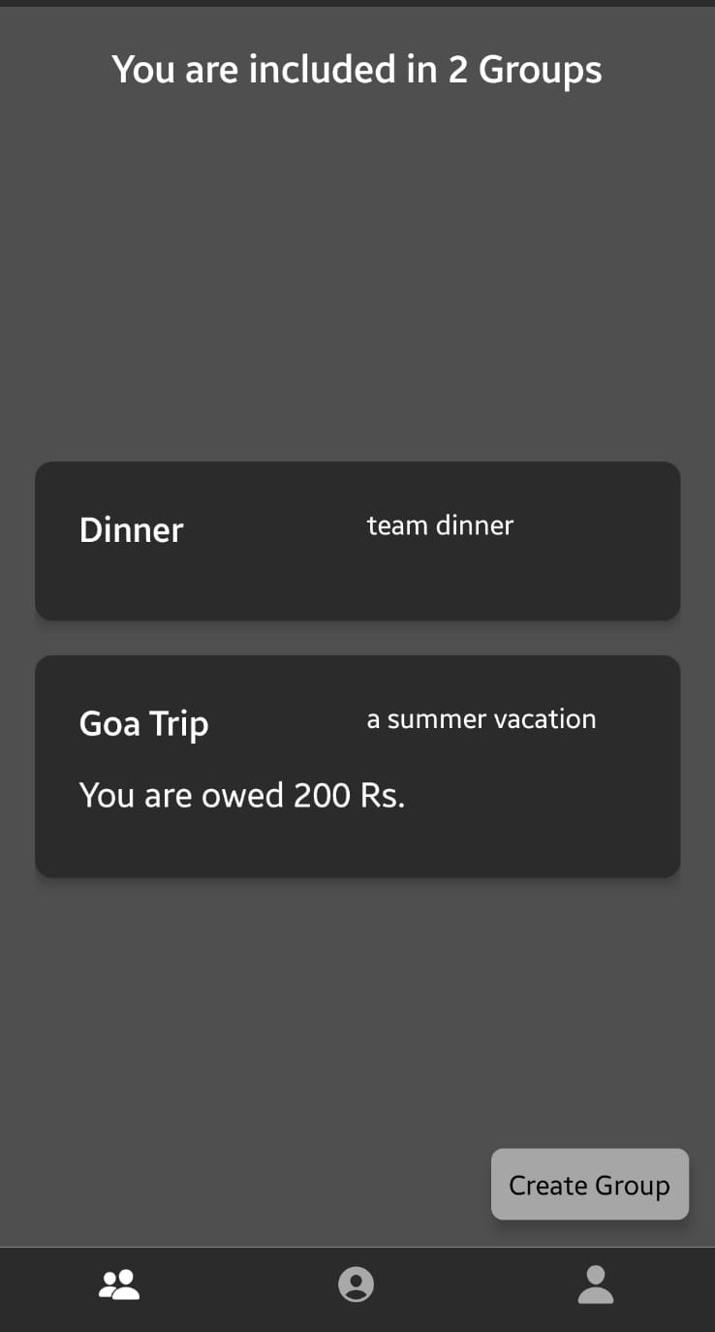
Workflow
Login
Sign-up
Home screen

Slide 8
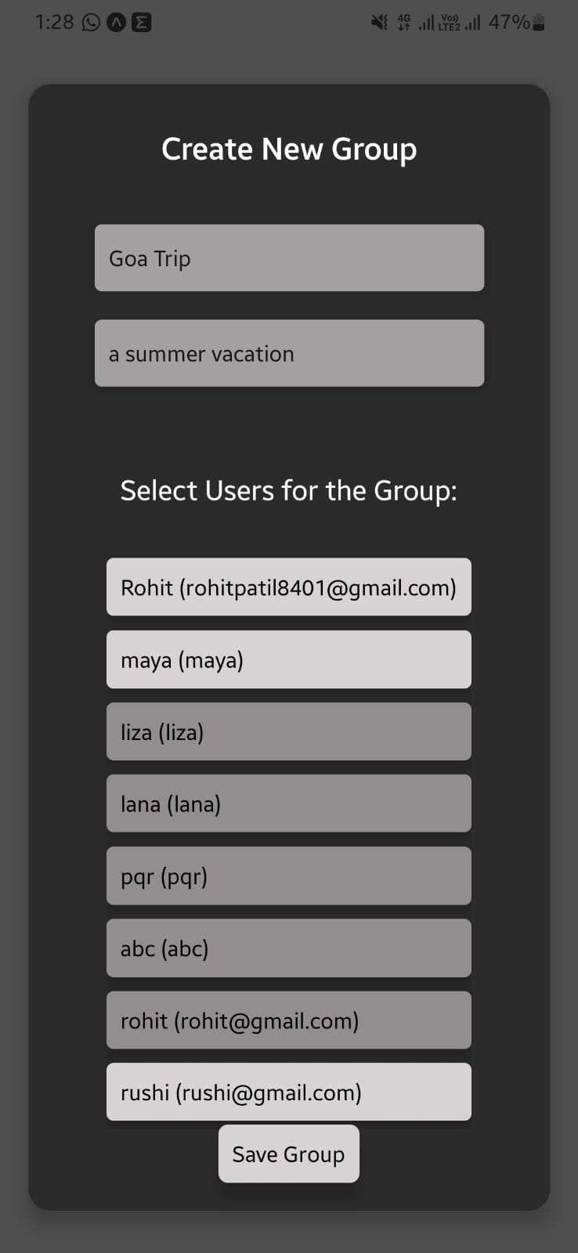
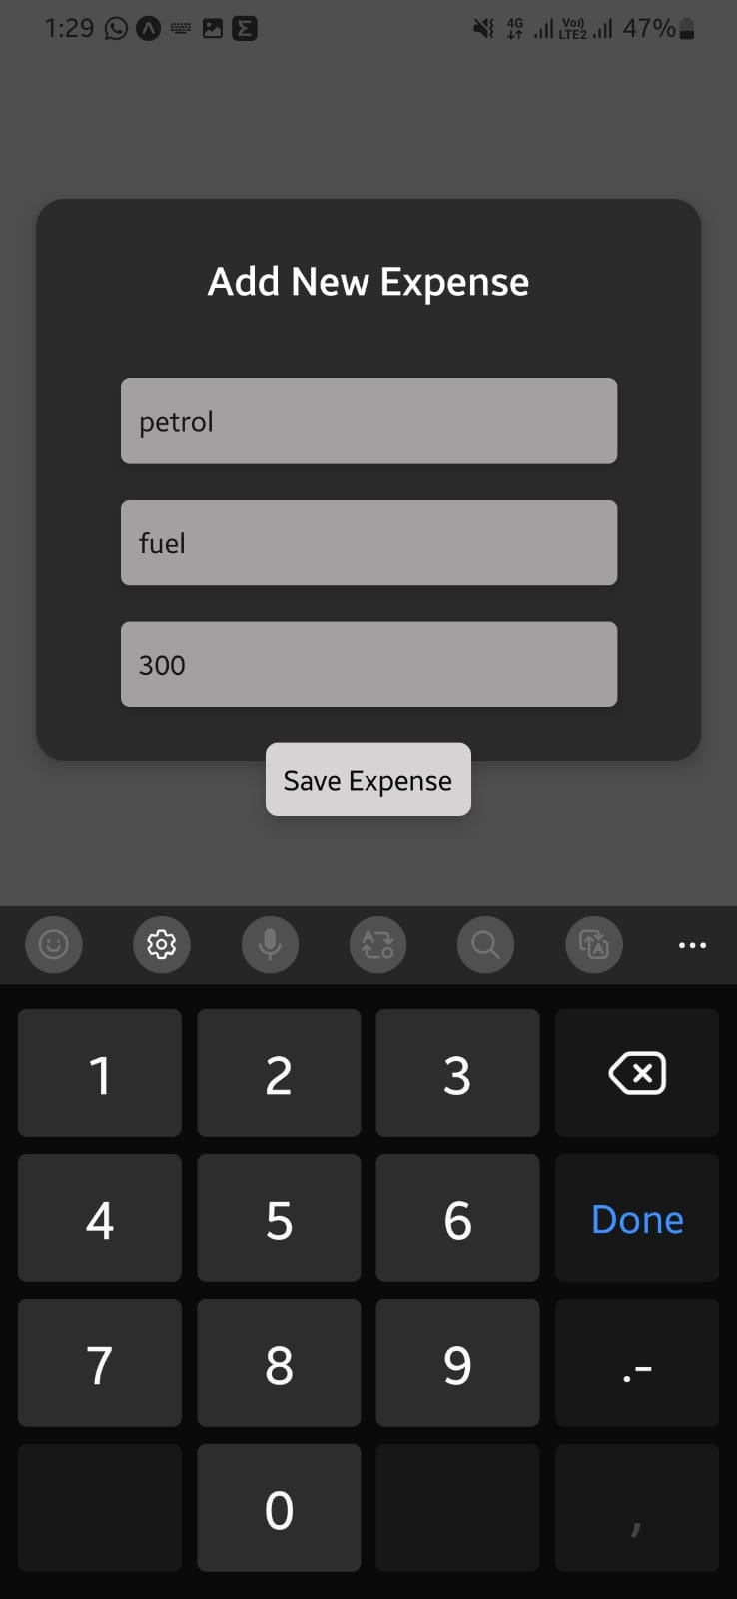
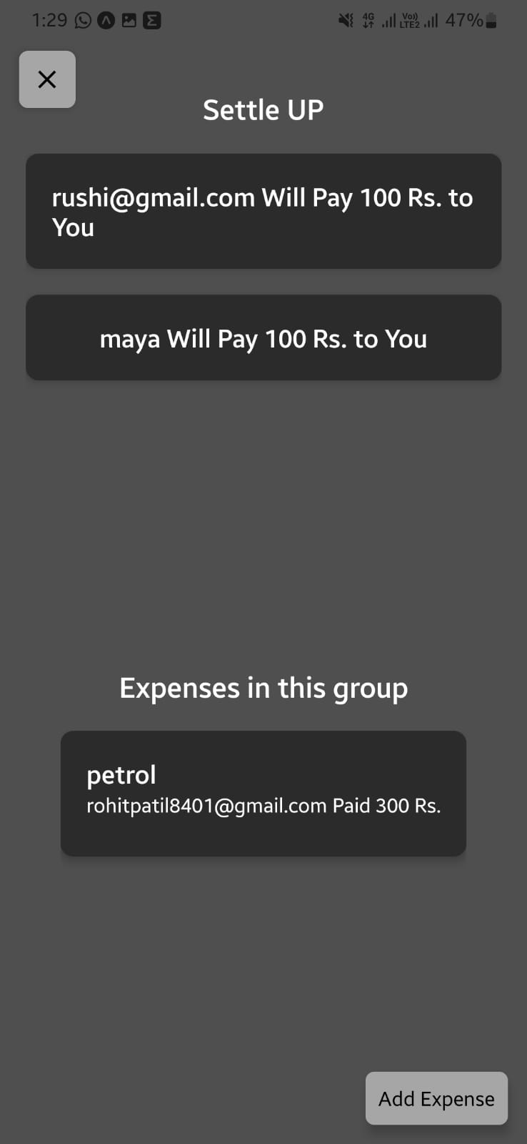
Workflow
Create Group
Add Expense
Payment Graph and expenses

Slide 9
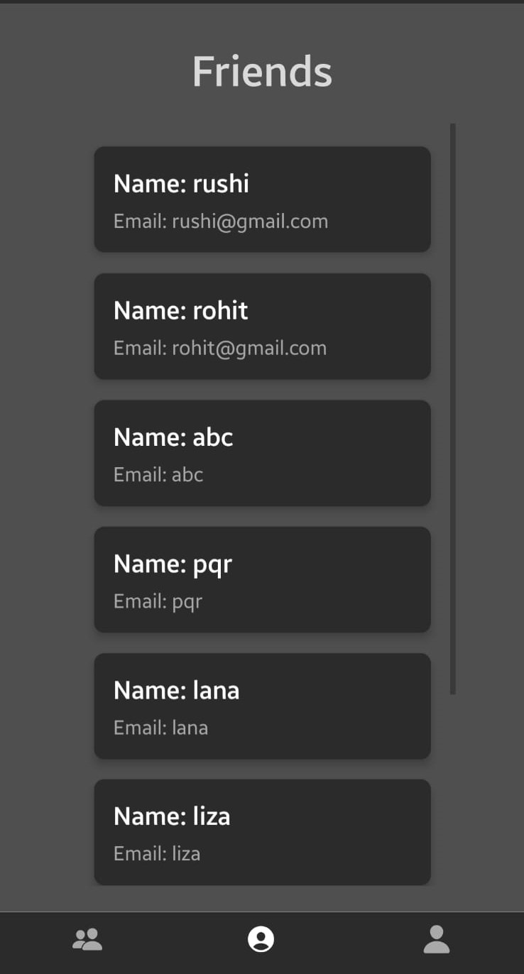
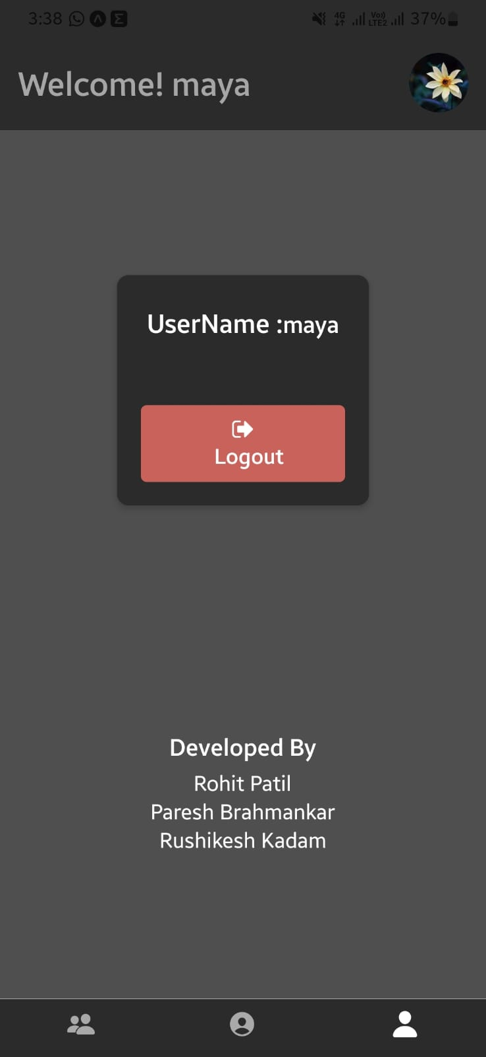
Workflow
List of Friends
Profile & Logout

Slide 10
Intricacies
Scenario: We were trying to add expenses/groups from one device But it was not reflecting in every device unless we request,
to handle this we will use Websockets(Event-driven)
Implementing algorithm to retrieve payment graph with CRUD operations
Adding encryption for passwords.
Securing API’s with OAuth2.0.
Authentication with Google Sign-in
Developing UI workflows.

Slide 11

Thank You

